Slide 1




Smart
Nyuki
Empowering Beekeepers with Data-driven insights through IoT.
BEE SMART, FARM SMART!

Slide 2






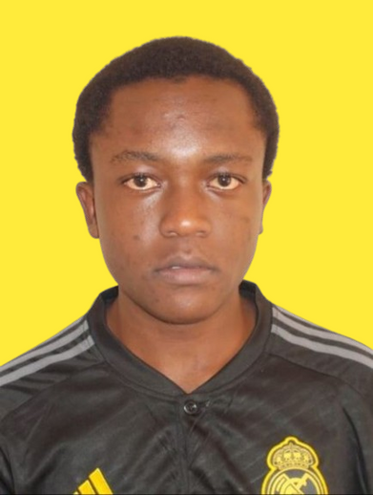

Meet the Team
Dr. Lawrence Nderu
Project Investigator
Brian Rop
IoT Engineer
James Karanja
IoT Engineer
Charles Mwangi
Front-end Developer
Moses Njau
Back-end Developer
Methusella Nyongesa
ML Engineer

Slide 3
The Silent struggle of Bees
Present loopholes in Traditional Beekeeping
Disturbance of Bee Activity through unnecessary inspections
Inconsistent Honey Production through estimation of harvesting times
Delayed Response to threats - pests and diseases
Lack of Timely Data to detect critical changes in hives, e.g. swarming

Slide 4





Solution
The Smart Nyuki application leverages use of IoT sensors and data analytics to gather data and monitor metrics such as temperature, humidity, sound and weight which would be used to give insight on the bee activity the health of the hive.
Remote Monitoring
Bee-Alert notifications
Non-intrusive hive management
Data-driven harvesting precision & decision-making

Slide 5







How SmartNyuki Works
Cloud
Hive 1
Gateway
Farmer’s mobile device
Hive 2

Slide 6


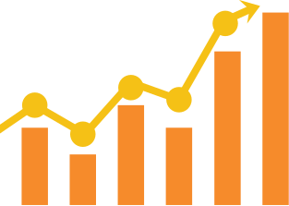
Target Market
Increasing number of Kenyan farmers and hobbysts estimated to be 90,340
Businesses that sell hives to farmers - Yatta Beekeepers
Conservation organizations dealing with apiculture
2 M
estimated hives in Kenya
4.2%
annual growth rate of the sector

Slide 7

Monetization
Subscription Model
Standard Plan and Premium plan
Equipment Sales
Sensors, communication devices, integration tools
Data Analytics Service
Customer reports, Predictive modelling
Consulting and Training
On-site workshops, Consultative training, Educational resources

Slide 8

Competitive Advantage
Competitive Advantage
A local solution that addresses localized problems
A local solution that addresses localized problems
Cost-effective for farmers
Cost-effective for farmers
Leveraging new and upcoming technology for prediction and analytics
Leveraging new and upcoming technology for prediction and analytics

Slide 9
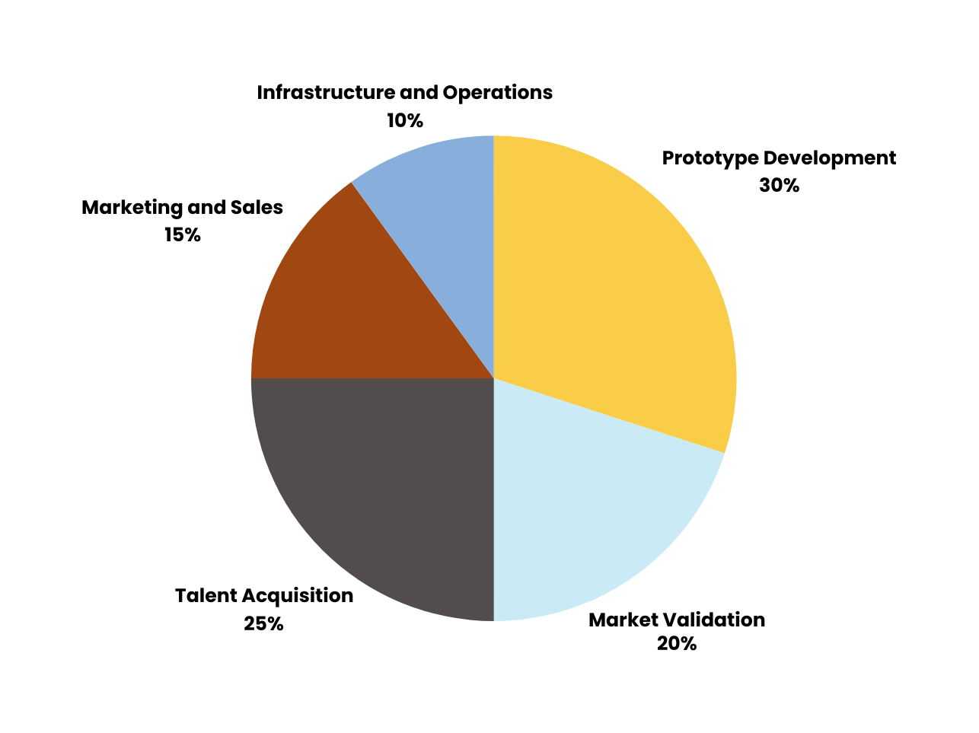
Capital Utilization

Slide 10

Potential Partnerships
Governmental Agencies - KALRO
Non- Governmental Organizations & For-Profit Organizations - Apiculture Platform of Kenya, Yatta Beekeepers
Financial Institutions & Impact investors in sustainable agriculture
Conservation Organizations - Happy Community Organization

Slide 11





The future of Smart Nyuki
Use advanced data analytics to assess hive conditions and make accurate predictions.
Bring on board more local experts for context-specific insights in developing a locally-informed solution.
Scale the project to extensively monitor more hives.
Integration with other agricultural technologies - Oakar services (GIS), Precision Development
Develop a mobile application

Slide 12


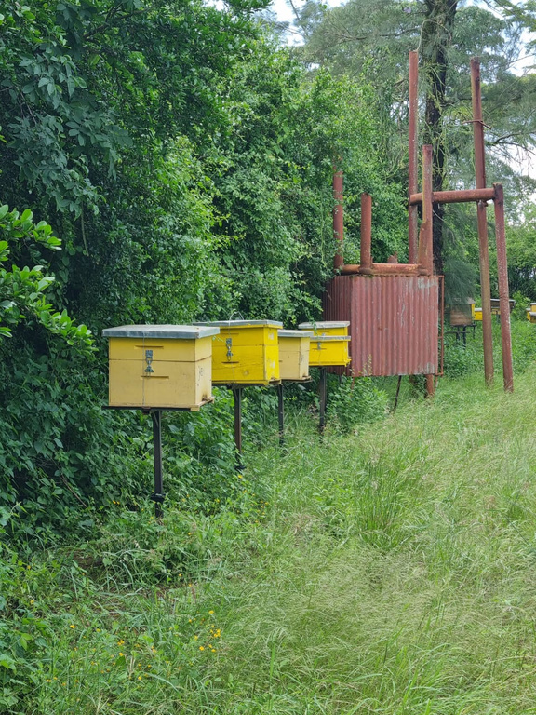
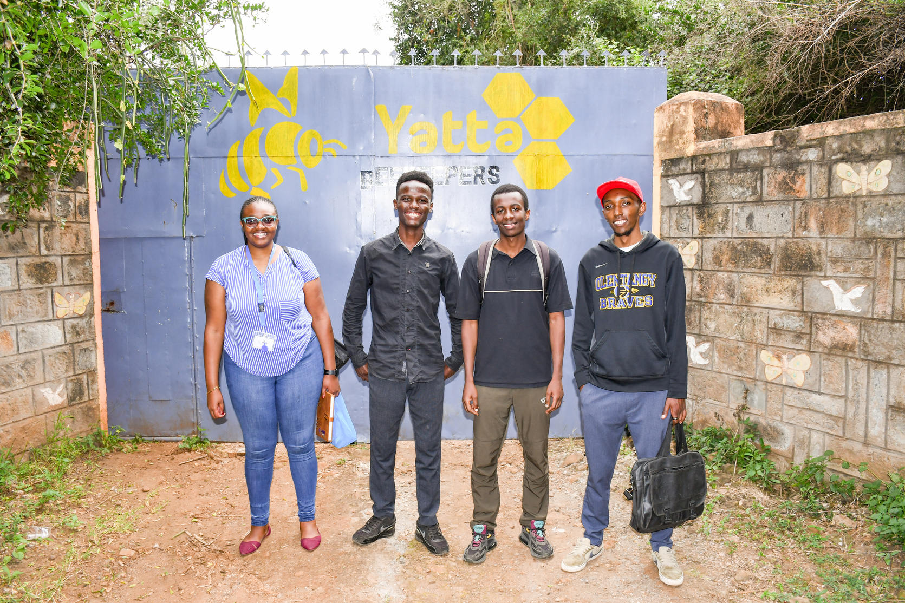
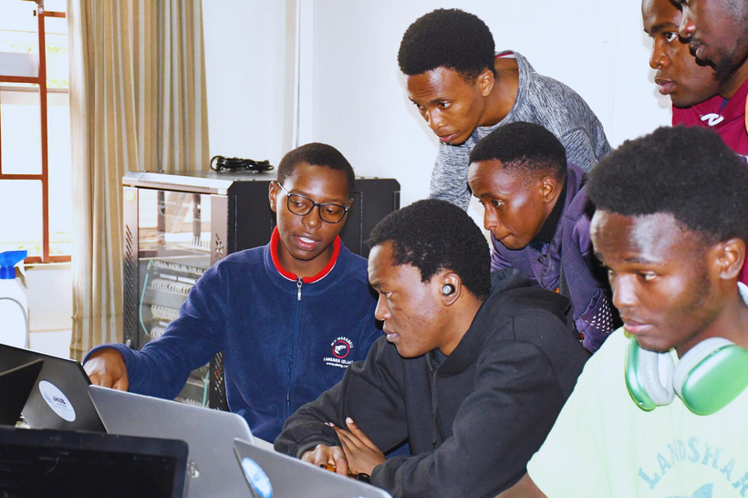
Thank You
smartnyuki.jhubafrica.com
smartnyuki@gmail.com

